Slide 1

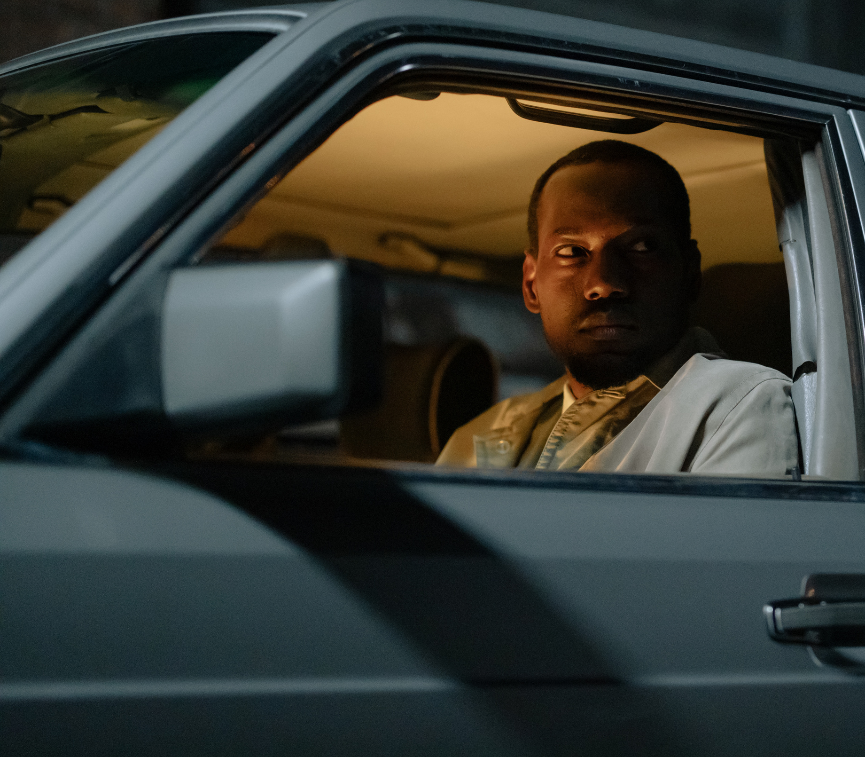
CRIMES IN LOS ANGELES
A Data Analysis project

Slide 2
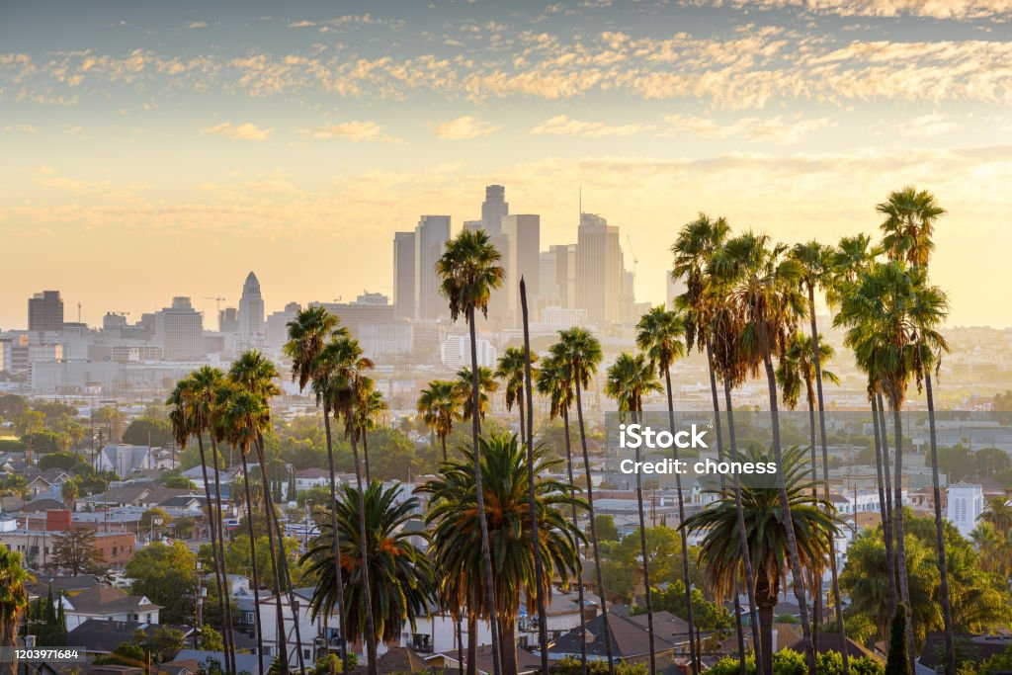
Los Angeles, California . The City of Angels. Tinseltown. The Entertainment Capital of the World! Known for its warm weather, palm trees, sprawling coastline, and Hollywood, along with producing some of the most iconic films and songs!
However, as with any highely populated city, it isn't always glamarous and there can be a large volume of crime.

Slide 3
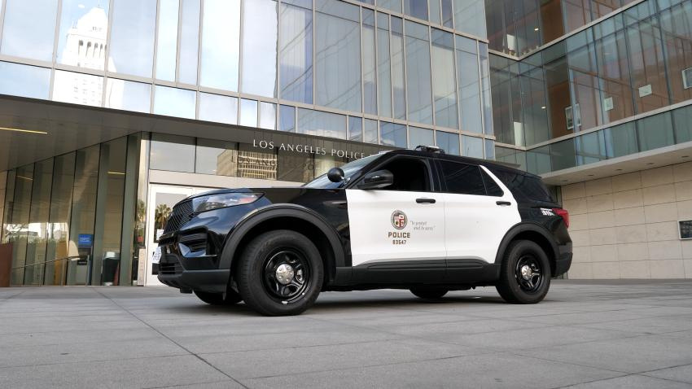
we have the official crime dataset which contains more the 800000 reported crime since the start of 2020 till present day, which we’ll try to analyze.

Slide 4
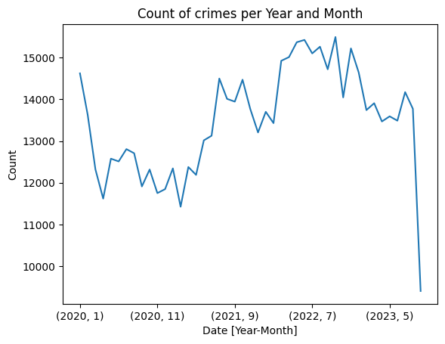
EDA
Numbers of crimes per Month and Year
Crime rates was decreasing since january 2020 maybe due to the lockdown of Covide-19, then started to increase since the begining of 2021

Slide 5
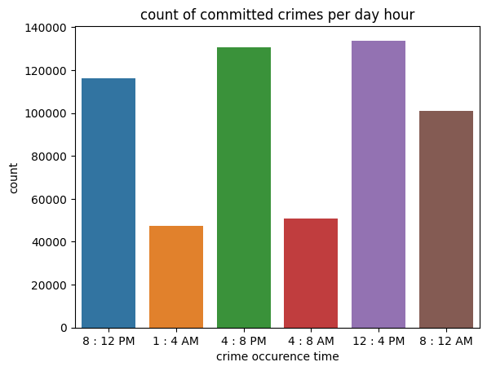
EDA
Does crime counts vary by time of the day?
it’s very strange that the majority of crimes happen in the middle of day between 12 - 8 pm

Slide 6
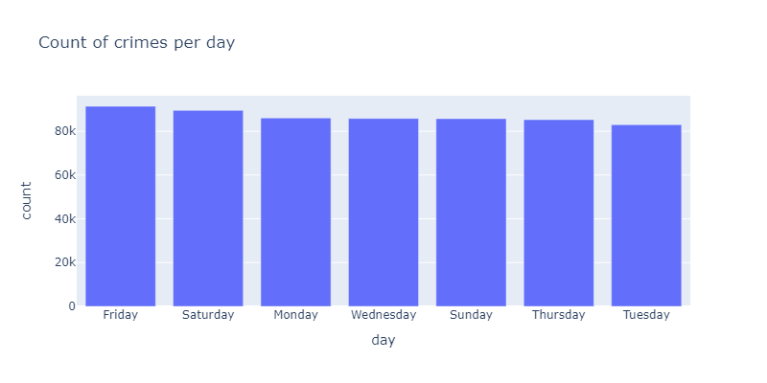
EDA
Does crime counts vary in different days?
we notice that crime counts don’t vary much, with friday has slightly higher crime rates

Slide 7
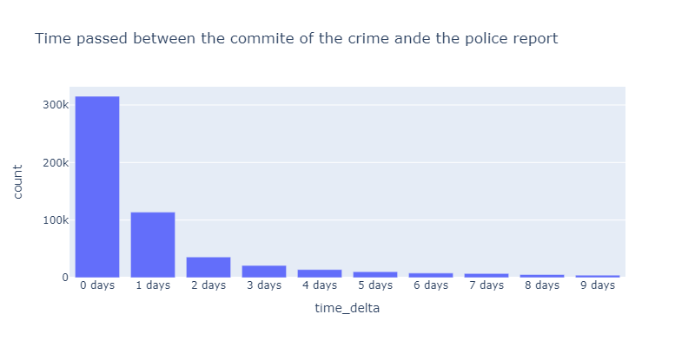
EDA
How long does it take to report a crime ?
the majority of crime get reported instantly in the same day

Slide 8
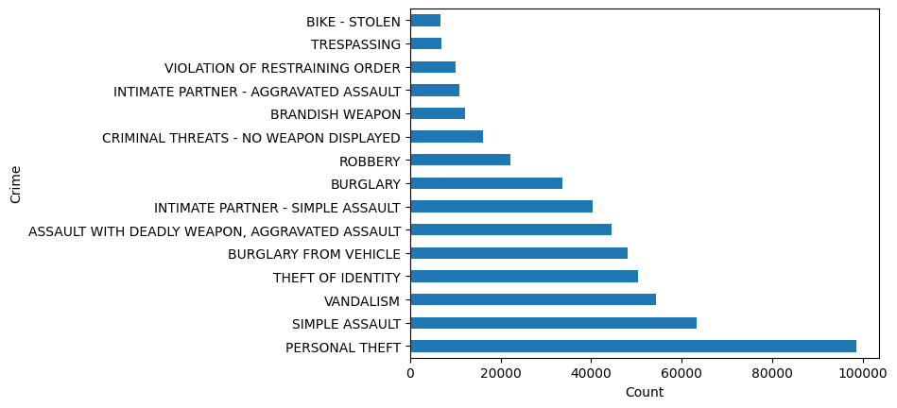
EDA
What are the top comitted crimes in LA?
Personal theft is the most comitted crime in LA, either a Grand theft ‘Higher thatn 1000 dollar’ or petty ‘less than a 1000 dollar’.
Simple assault comes second as most comitted crime

Slide 9
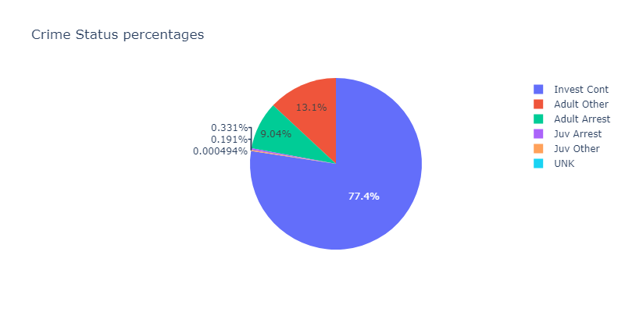
EDA
How the investigation - crime status - is going?
The majority of crimes haven’t been solved and still under investigation, with small percentage of arrested adults

Slide 10
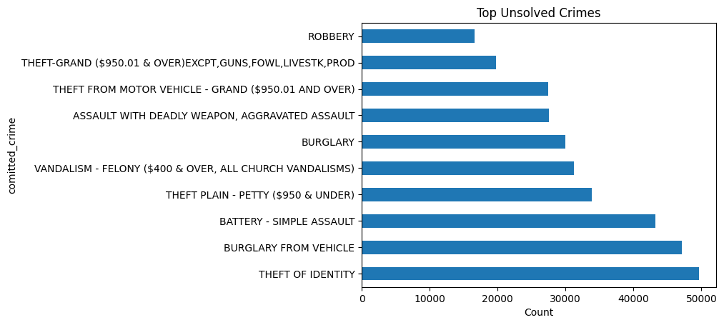
EDA
How the investigation - crime status - is going?
The highest percentage of unsolved crimes are Identity theft with nearly 50000 crimes still under investigation

Slide 11
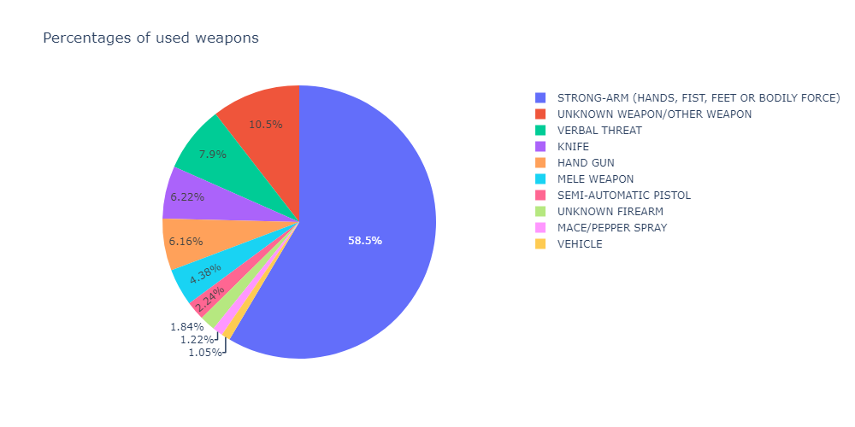
EDA
what are the differrent weapons use in Crimes?
the highest used weapon is Bodily force such as hands and fists with more than a 140000 crimes, tracked to the most committed crime which is simple assault

Slide 12
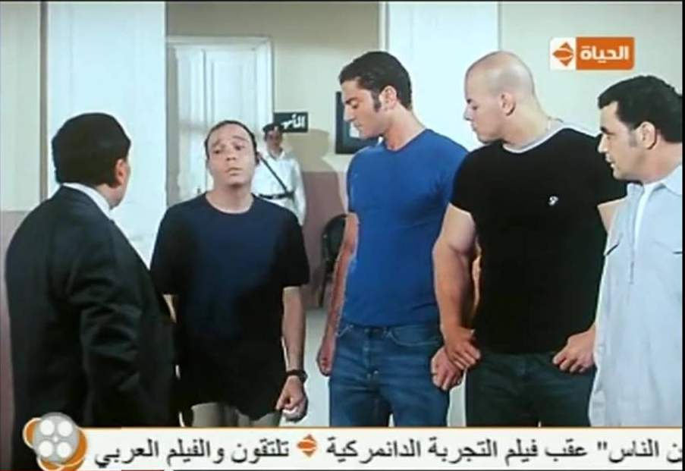
Hand Gun
strong arm
verbal threat
Semi-Auto Pistol
knife

Slide 13
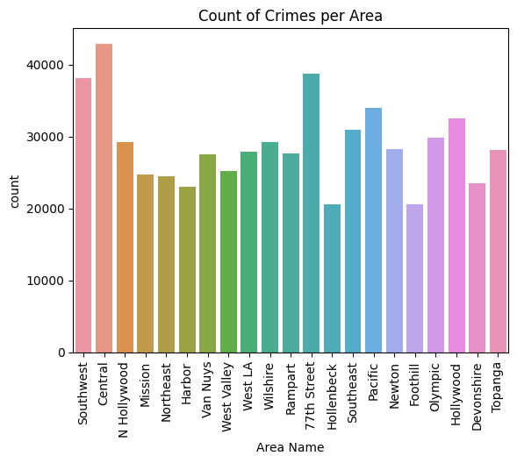
EDA
Which areas have the highiest and lowest crime rates?
LA has 21 Geographic Areas or Patrol Divisions are also given a name designation that references a landmark or the surrounding community that it is responsible for.
Central
Southeast
77th street
are the top 3 areas with high crime rates
Hollenbeck is the area with the least reported crime rate

Slide 14
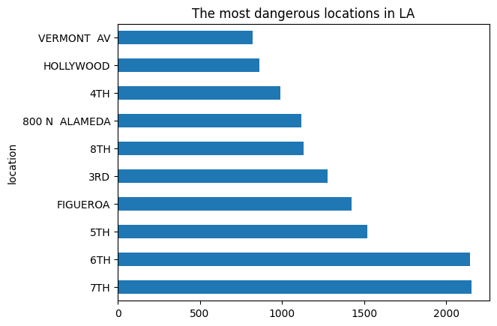
EDA
which locations are the most dangeorous in LA?
7TH & 6TH streets are by far the top locations with crimes committed over 2000 each

Slide 15
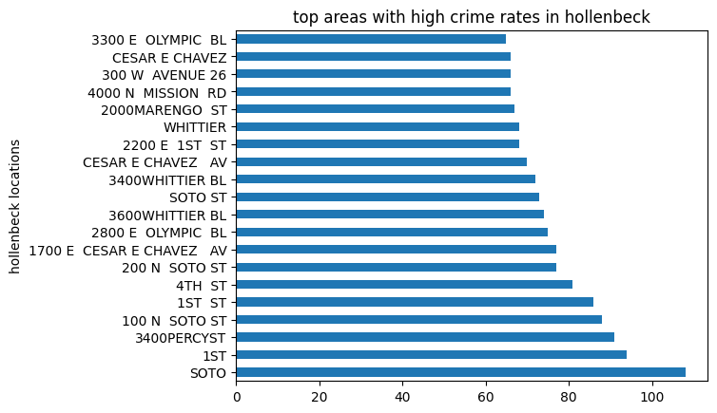
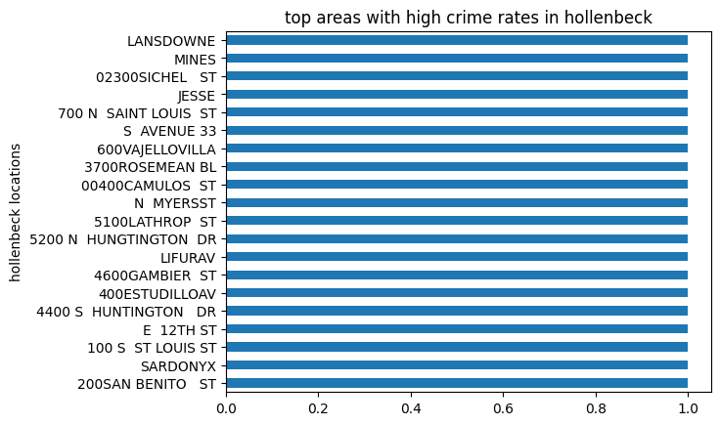
EDA
Which locations has the least crime rates?
most hollenbeck locations has only one reported crime in 3 years
Even the highiest area in crimes in hollenbeck has a bit over a hundred reported crime in 3 years which is Soto.

Slide 16
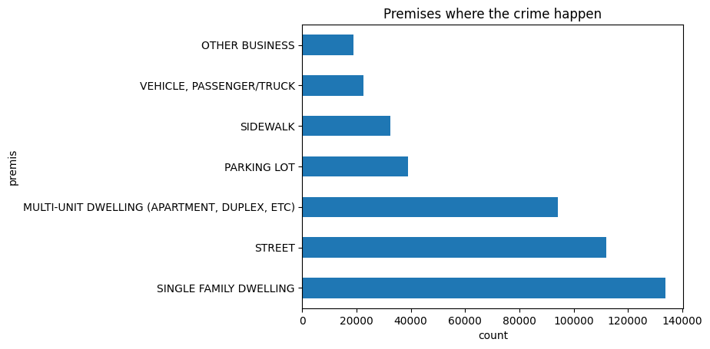
EDA
What kind of premises do crime happen?
The majority of crimes take place in a single family flat then in the streets

Slide 17
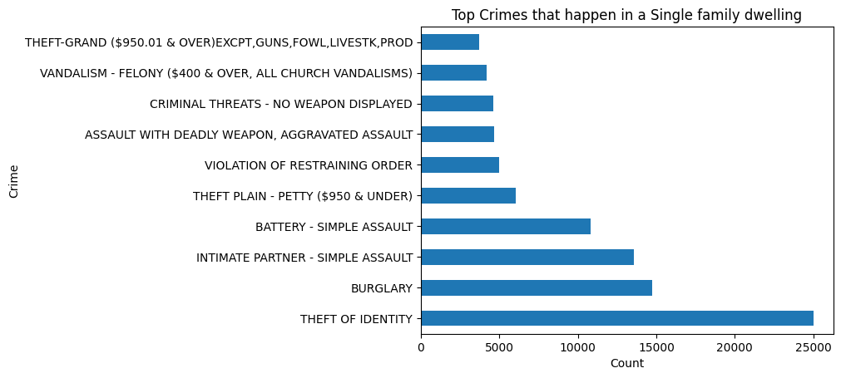
EDA
Which type of crime happen the most in a Single Dwelling?
Identity theft has the majority of crimes, then comes up the burglary

Slide 18
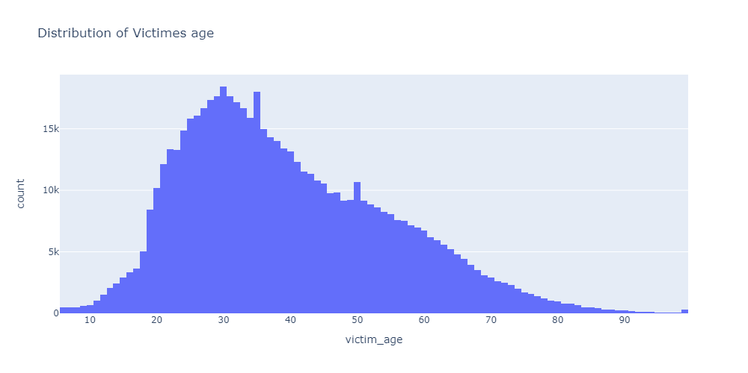
EDA - VICTIMS AGE
The majority of victims are between the age of 20 and 50, with low percent of victim below 20 and over 80

Slide 19
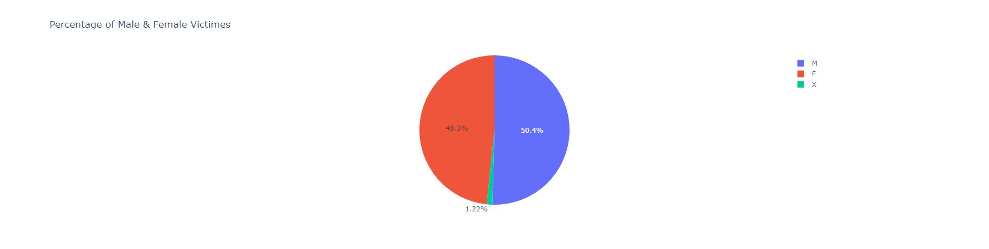
EDA - VICTIMS GENDER
There’s not a huge difference in victim genders being assaulted, with a small percentage of unknown victim gender

Slide 20
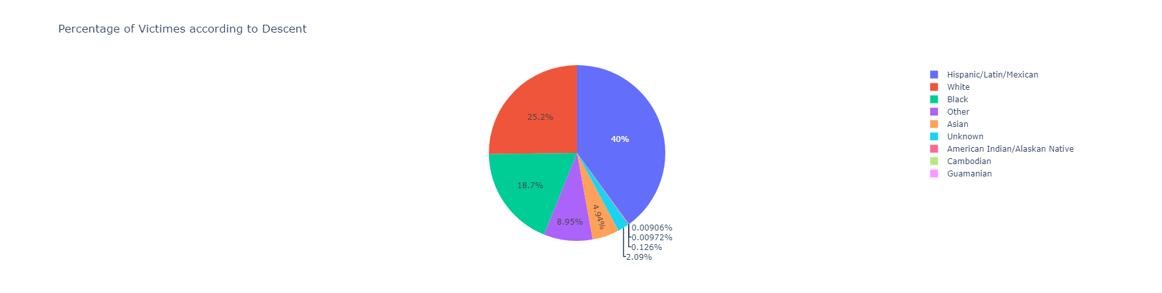
EDA - VICTIM DESCENT
Most affected descent are Mexicans, Hispanics and Latinos which is reasonable because they are close to 50% of LA population, then comes up blacks and whites

Slide 21
WHAT’S NEXT?
We can build a time series machine learning model build to predict future crimes

Slide 22
HOW CAN WE REDUCE CRIME RATES?
INCREASE RESTRICTIONS OVER BUYING WEAPONS SPECIALLY DEADLY ONES
MORE POLICE PATROLS IN AREAS AND LOCATIONS WITH HIGH CRIME RATES (CENTAL AREA, 7TH ST, 6TH ST)
MORE POLICE PATROLS DURING PERIOD OF TIME THAT SHOWED HIGHER CRIME RATES ( 12 PM - 8 PM )
ASSIGNING MORE PROFESSIONAL DETECTIVES FOR IDENTITY THEFT CRIMES SENCE NEARLY 100% OF THIS CRIME GOES UNSOLVED
IF YOU’RE TO BUY A HOUSE AVOID CENTRAL AREA, HOLLENBECK IS ADVISED
DON’T BE A MEXICAN

